Slide 1
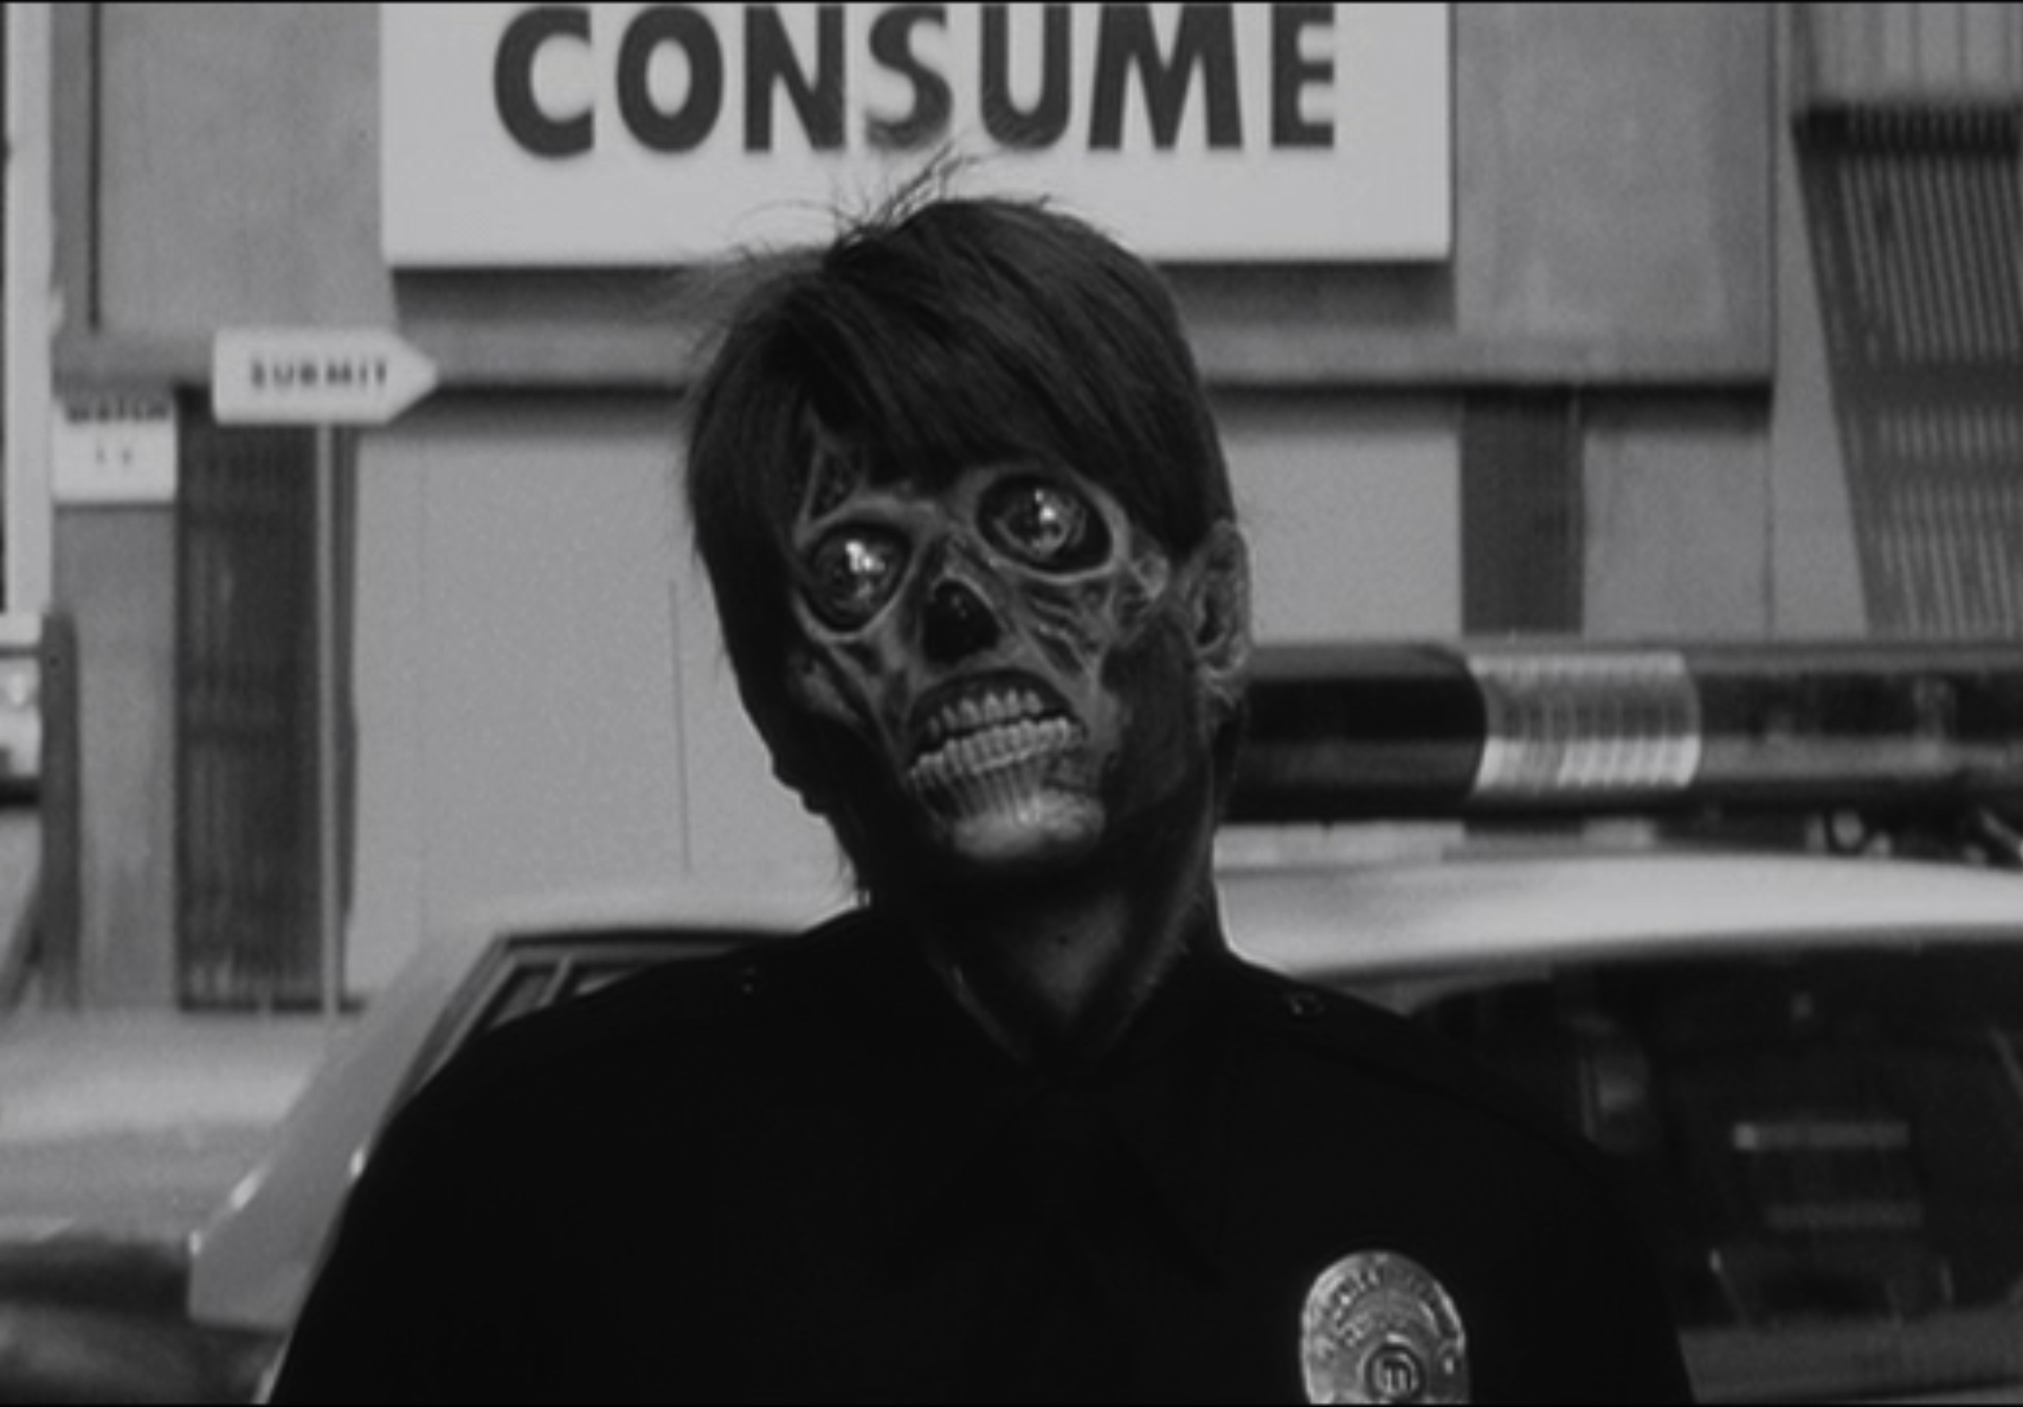


Infinite Jest and the “High”/“Low” Art Dichotomy
Taylor Backman, Literature, tbackam@ucsc.edu
David Foster Wallace’s 1996 novel Infinite Jest poses the question: “What should we give ourselves away to?” Reflected in the three intertwining plots of Infinite Jest, the reader is asked to consider the following: Do we give ourselves to the pursuit of pleasure, and consumption of entertainment? Do we give ourselves to the pursuit of achievement and transcendence, thereby making the necessary sacrifices that our goals dictate? Is there a way to “recover” from our choices, should we need to? And will “recovery” set us free, or must we “give ourselves” to the ongoing process of “recovery,” completely? These questions are where my project began.
The problem with choosing between the transcendent or the escapist, between “High” or “Low” Art, is that they amount to the same thing. In ‘Spider Woman,’ Valentin warns Molina against escapism, yet fails to realize that transcendence is also a form of escape. Transcendence (to exceed or surpass limits), and escapism (to seek distraction from an unpleasant situation or retreat into fantasy) work on the same mechanism: both allow the self to retreat from, or move beyond, “the cell” of reality. Therefore, I propose an elimination of the “High”/“Low” dichotomy. Of course, I am not the first to argue for this; it is a common postmodernist position. As Lawrence Alloway writes, who was a prominent theorist of the pop art movement in the 1950s and 1960s, pop art was taking “Pop culture out of the realm of ‘escapism,’ ‘sheer entertainment,’ ‘relaxation,’ and to treat it with the seriousness of art (quoted from Storey’s Cultural Theory and Popular Culture: An Introduction, page 199).
What Do We Give Ourselves Away To?
The End of “High” and “Low” Art
I chose to put Manuel Puig’s 1976 novel Kiss of the Spider Woman into conversation with Infinite Jest for two reasons: 1) to contribute to building world literature that is not restricted by national canons; and 2) because of an important conversation that Molina and Valentin, two imprisoned characters from ‘Spider Woman,’ have in the novel. On the one hand, Valentin is a revolutionary who favors transcendence through reading and study; and on the other, Molina prefers old Hollywood movies and thinking “about nice things,” which as Valentin warns, can become a “vice” (78). Here we can rework Infinite Jest’s question to the following: Do we “give ourselves” to the pursuit of transcendence or escape? Should we favor “High” and transcendent, or “Low” and escapist art?
I propose, however, a reformation of Alloway’s idea of elevating “Low,” or Popular Art to a treatment of “seriousness.” What I propose is a complete rejection of the “High”/“Low” Art hierarchy, and instead, to think of all art as situated in a horizontal landscape of entertainment. In other words, I’m arguing that there is no “serious” art: there is only entertainment. Some people may be entertained by Duchamp’s Fountain, while others may find an episode of Battlestar Gallactica more stimulating. By recognizing all art as being different forms of entertainment, and most importantly, that not everyone will be entertained by the same things, we can do away with classist prejudices and institutionalized cultural elitism. In this way, and here I build off the work of Raymond Williams, we may evaluate all art or entertainment on level footing; we can see how each entertainment works, and what value or meaning it has within our culture without hierarchical bias.
Transcending and Escaping
A Horizontal Landscape
Research generously supported by the Institute for Humanities Research, and UCSC Literature Department
Image from Universal Studios’ They Live (1988)

