Slide 1
In Debt: A Reconsideration of “Race, Empire, and the Crisis of the Subprime” from Manna-Hata
Joanne Barker (Lenape)
A great many people in North America believed that Canada and the US, in a moment of inexplicable generosity, gave treaty rights to Native people as a gift. Of course, anyone familiar with the history of Indians in North America knows that Native people paid for every treaty right, and in some cases, paid more than once. The idea that either country gave First Nations something for free is horseshit.
Thomas King (Cherokee), The Inconvenient Indian jmbarker@sfsu.edu http://online.sfsu.edu/jmbarker

Slide 2
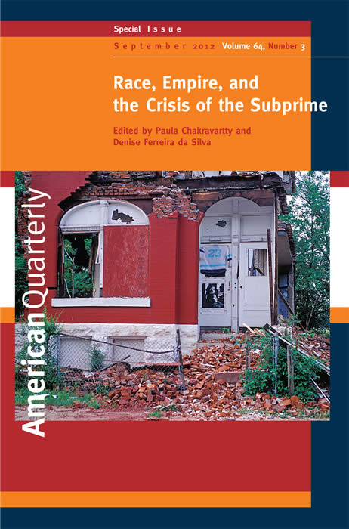

Slide 3

Quentin Tarantino,
Django Unchained (2012)
“America is responsible for two Holocausts: for the destruction of native Americans and for the slavery of African Americans…. We’ve dealt with the Indian Holocaust, the Holocaust of the Indian American. We haven’t been dealing with the Holocaustic aspects, the Auschwitzian aspects of the slave trade in America.”

Slide 4
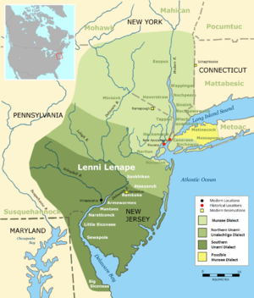
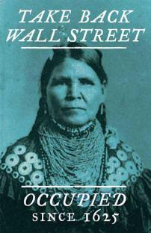

Slide 5
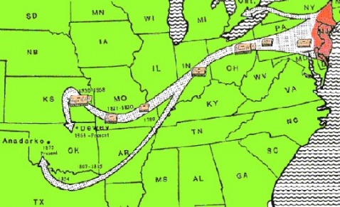
US-Lenape ratified treaties: 1778, 1785, 1795, 1803, 1804, 1805, 1809, 1814, 1815, 1817, 1818, 1829, 1832, 1843, 1854, 1860, 1861, 1866
Johnson v. M’Intosh (1823)
General Allotment Act (1887)
Lone Wolf v. Hitchcock (1903)
Indian Claims Commission (1946-1978)

Slide 6
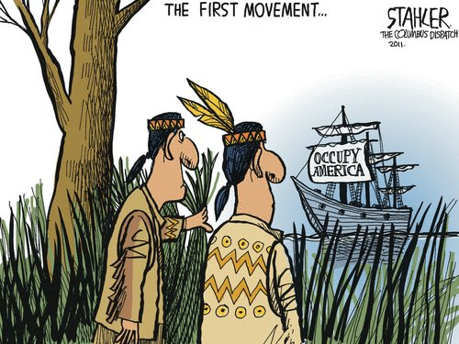
Indebted
BIA.gov
565 federally recognized tribes
1,978,099 enrolled members
56.2 million acres of reservation lands
326 reservation land areas from 1.32 (Pit River) to 16 million (Navajo) acres
10.6 million acres in individual trust

Slide 7
Census 2010
Census.gov
American Indians/Alaska Natives 2.9 million (1.7% of national population)
22% reside on reservation lands
54% own their homes (national average 65%)
28.5 percent live at or below the poverty line (national average 15.3%)
Live without health insurance 29.2% (national average 15.5%)
Native Hawaiian or Other Pacific Islanders 1.2 million (0.4 percent nationally). 17% live at or below poverty line and 17.4% are without health coverage

Slide 8
Debt Traps
“28.9 percent of American Indians and Alaska Natives are underbanked, and 15.6 percent… are unbanked.”
Refund anticipation loans average 178 percent on top of fees charged for tax preparation
Payday loans percentage rate from 390 to 780 percent.
Auto loans 30-40 percent above retail

Slide 9
The Subprime Crisis
“In the nation as a whole, subprime and manufactured home lenders made 19.5 percent of all the conventional home purchase loans to Native Americans in 2001, but only 9.6 percent of the loans to whites. In other words, the high-cost lender market share was 2.04 times greater to Native Americans than to whites.”
National Community Reinvestment Coalition and the National American Indian Housing Council (2003)

Slide 10
NM, SD, CA
In New Mexico, which exhibited one of the highest disparities in subprime lending to Native communities, 63.8 percent of loans were issued to Natives and 9.6 percent to whites. “Another way of stating this disparity is that Native Americans were 6.66 times more likely to receive a mortgage loan from a high-cost lender than a prime lender.”
In South Dakota, 34.8 percent of the loans were issued to Natives and 11.2 percent to whites; this would mean Natives were 3.10 times more likely than whites to be issued subprime mortgages.
In California, Natives received 20.2 percent of high interest loans and whites 7.7; Natives were 2.46 times more likely than whites to receive a subprime.

Slide 11
Nationwide
9 percent average threshold rate defining high-cost mortgage lending to Native people (compared to the 3 to 4 percentage rate nationwide).
Native mortgage rates as high as 25 percent and mobile home rates as high as 24 percent

Slide 12
Land Trust
“As the percentage of land in tribal trust increased, the perception of the extent of predatory [subprime] lending decreased.”
63 percent approval rate for mortgage loans to Natives living on and near reservation communities, compared to 83 percent national average.

Slide 13
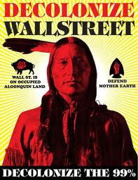
Foreclosure Risk
According to a Center for Responsible Lending report of 2010, of the 2.5 million foreclosures completed since 2007 as well as the 5.7 million who are at imminent risk of losing their homes to foreclosure today:
American Indians/Alaska Natives 16.5%
Native Hawaiians and other Pacific Islanders 18.6%
African Americans 21.6%
Latinos 21.4%
Asian Americans 15.7%
non-Hispanic whites 14.8%
Others 17.8%

Slide 14
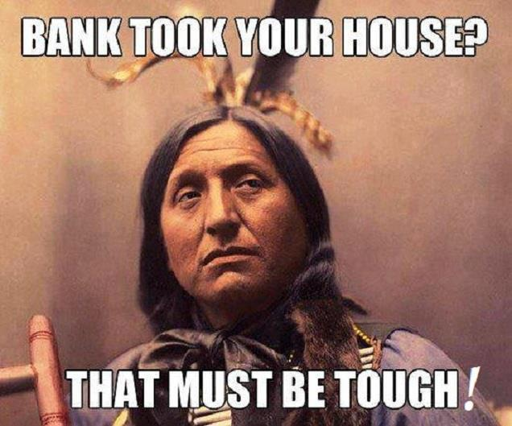
Conclusions
“The system ain’t broke. It was built to be this way.”
Tom B.K. Goldtooth (Dine and Dakota),
“Occupy Talks” (2012)

Slide 15
