Slide 1
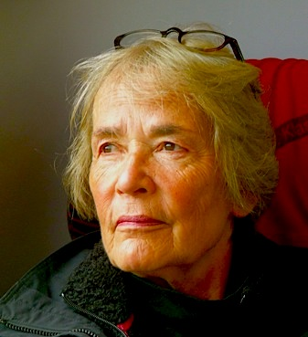

Hedy Rose:
"Living the Life of Anne Frank:
A Childhood in Hiding"
Dr. Hedwig C. Rose, education specialist and former Director of Education Studies at Wesleyan University, was born in Amsterdam, The Netherlands. After her father, his five brothers and their families were rounded up by the Nazi occupiers in 1942, she spent three years hidden in an Amsterdam cellar. She came to the United States in 1947.
Tuesday, February 18
10:00-11:45 AM
Humanities 1, Room 210
A visiting fellow at the Nederlands Instituut voor Oorlogsdocumentatie (War Document Archives) in Amsterdam in 2008, for past eight years she has been visiting scholar at the Hoover Institution at Stanford University, where she is continuing her research for a book on The Netherlands before and during World War II.
This lecture was presented by the Center for Jewish Studies with support from the Neufeld Levin Holocaust Chair Endowment.

